Slide 1

Engineering Chemistry-1 (BS109)
Periodicity in Properties of Elements in the Periodic Table
Dr. Shruti Khanna Ahuja
Assistant Professor
USAR, GGSIPU

Slide 2
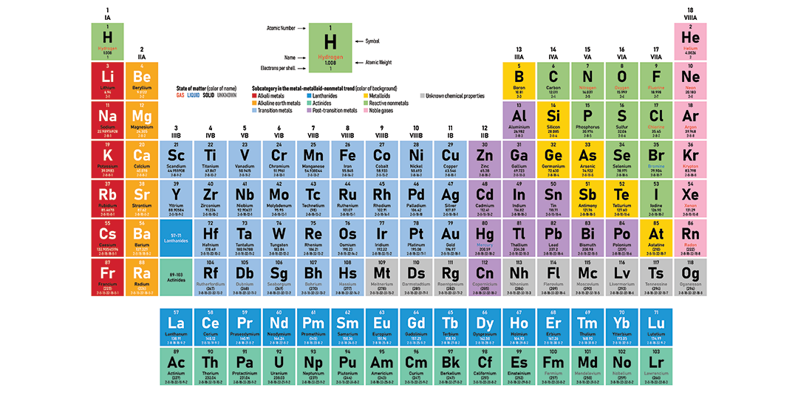
Long Form of Periodic Table

Slide 3
Long form of Periodic Table:
Based on modern periodic law, according to which the physical and chemical properties of the elements are the periodic functions of their atomic number. Therefore elements are arranged in increasing order of their atomic numbers from left to right across each row.
It consists of 18 vertical columns and 7 horizontal rows.
Vertical columns are known as Groups in the Periodic Table
1. There are 18 groups in the periodic table.
2. They are numbered from 1 to 18.
3. Each group consists of elements having the same outer shell electronic configuration.
Horizontal rows are known as Periods in the Periodic Table
1. There are 7 periods in the periodic table.
2. They are numbered as 1, 2, 3, 4, 5, 6 and 7 from top to bottom.
3. The 1st period consists of only two elements i.e. hydrogen and helium.
4. 2nd and 3rd period consist of 8 elements each, 4th and 5th period consist of 18 elements each, 6th and 7th period consists of 32 elements.
5. Also, the long form of the periodic table consists of a separate panel at the bottom. It consists of 14 elements of the 6th period 14 elements in the 7th period.
6. Each period represents the number of shells or energy levels present in an atom of an element i.e. highest principal quantum number (n) of the elements in the period
7. The cause of periodicity in properties is the repetition of similar outer electronic configuration after certain regular intervals.

Slide 4
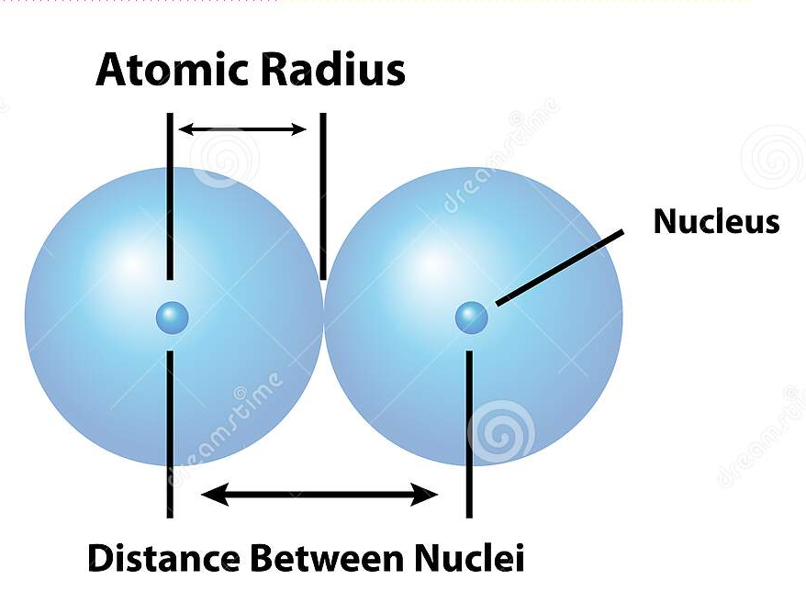
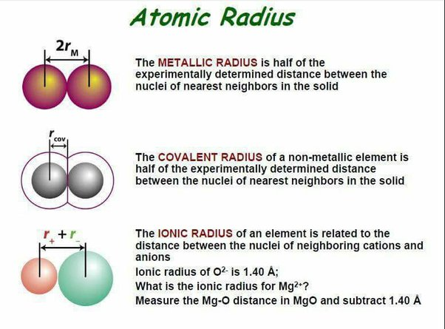
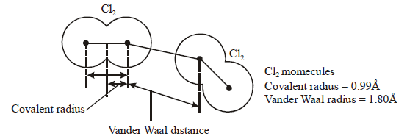
(1) Atomic Radius : distance from the nucleus to the outermost electron.
Most of the time atoms are not in atomic state, so radius is measured as covalent radius, van der Waals radius and metallic radius.
Covalent radius: one half of the internuclear distance in the homonuclear diatomic molecule. This is generally used for non-metals. The bond distance in the chlorine molecule (Cl₂) is 198 pm and half this distance (99 pm), is taken as the atomic radius of chlorine.
Metallic radius: half of the internuclear distance separating two adjacent metal atoms in a metallic lattice. Distance between two adjacent copper atoms in solid copper is 256 pm; hence the metallic radius of copper is assigned a value of 128 pm.
van der Waals radius: half the closest distance between two immediately adjacent atoms (either of same or different elements) in the structure of the solid compound in which they are not bonded to each other. It is always greater than the covalent radii as (i) the latter is formed by the overlap of two half-filled atomic orbitals, (ii) van der Waals forces of attraction are weak, internuclear distances between atoms held by these forces are is much large.
van der Waals radius > metallic radius > covalent radius

Slide 5
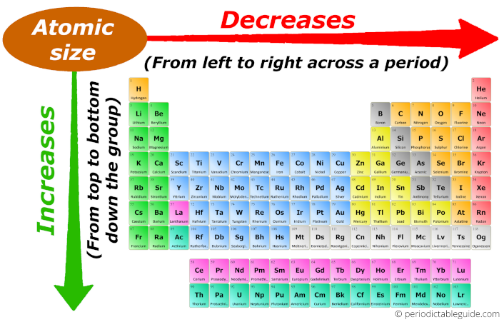
Variation in a period:
In s- and p- block elements, atomic radius decreases with increase in atomic number in a period because the effective nuclear charge (Zeff ) increases across the period.
The size of atoms of inert gases are larger than those of the preceding halogens owing to their completely filled orbitals resulting in maximum inter-electronic repulsions
For d-block elements, atomic radius initially decreases, then remains constant and finally increase again.
Variation in a group:
For s- and p- block elements, the atomic radii increases down the group due to the addition of a new energy shell.
For d-block elements, the trend in atomic radii is: r_{3d series} < r_{4d series} < r_{5d series}. This is because the radius increases as the shell number increases.
The radius of elements of 4d- series is about the same as elements of 5d series. This is due to the lanthanoid contraction that causes increase in Z_{eff} value due to poor shielding of f electrons.
For f-block elements, in lanthanoids, the effective nuclear charge increases along the period so the atomic radius for the elements decreases. For actinoids, there is also a decrease in atomic radius from Th to Lr.

Slide 6
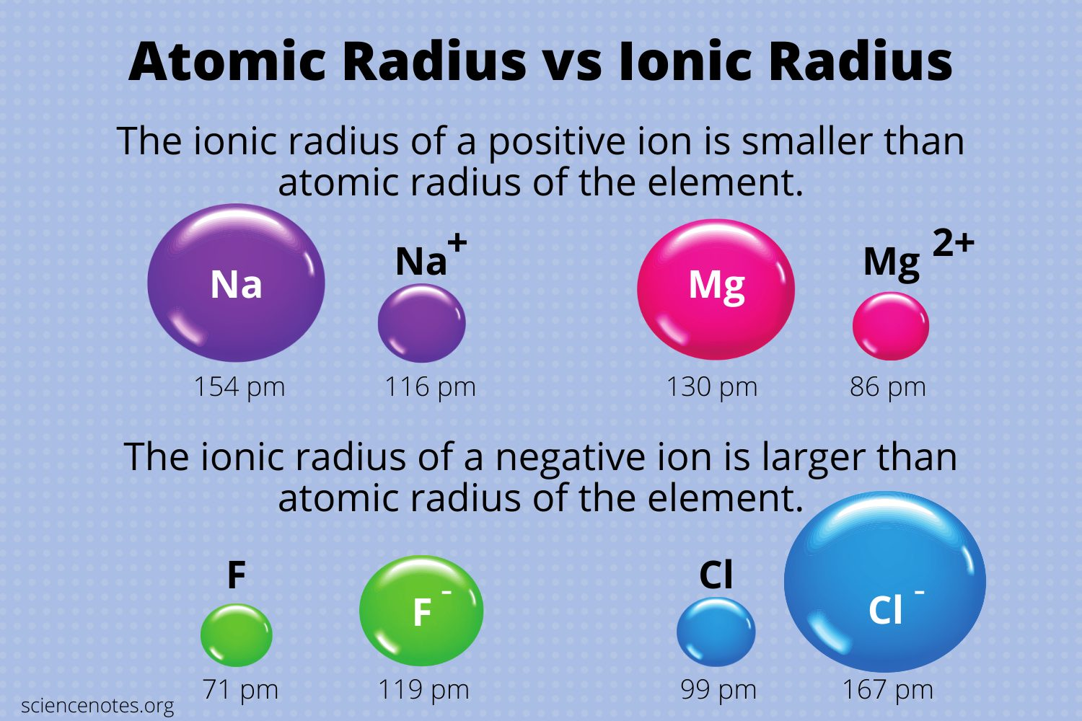
(2) Ionic radius : the effective distance from the center of the nucleus of the ion upto which it exerts its influence on its electronic cloud, i.e. distance between the nuclei of neighboring cations and anions.
When a positive ion (cation) is formed, effective nuclear charge is increased resulting in strong attraction of electrons by the nucleus. Also, there is a decrease in the number of shells. Thus a positive ion is always smaller than the corresponding atom and more the electrons removed smaller is the ion.
When a negative ion (anion) is formed, one or more electrons are added to an atom which results in reduced effective nuclear charge causing inter-electronic repulsions. As a result, electron cloud expands and the size of anion is more than that of the atom.

Slide 7
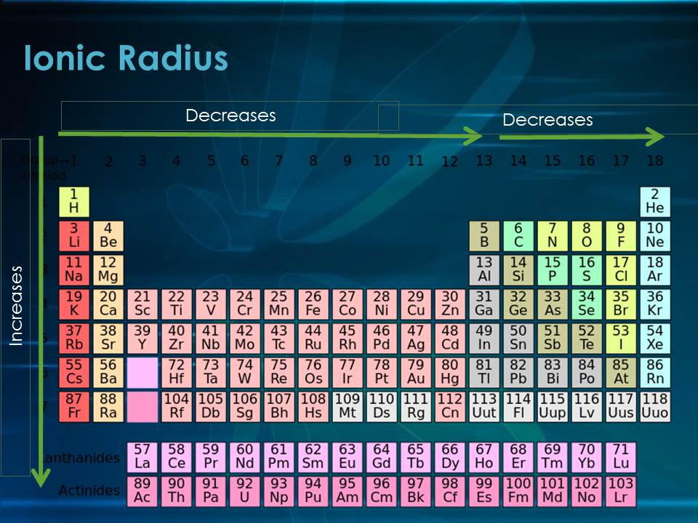
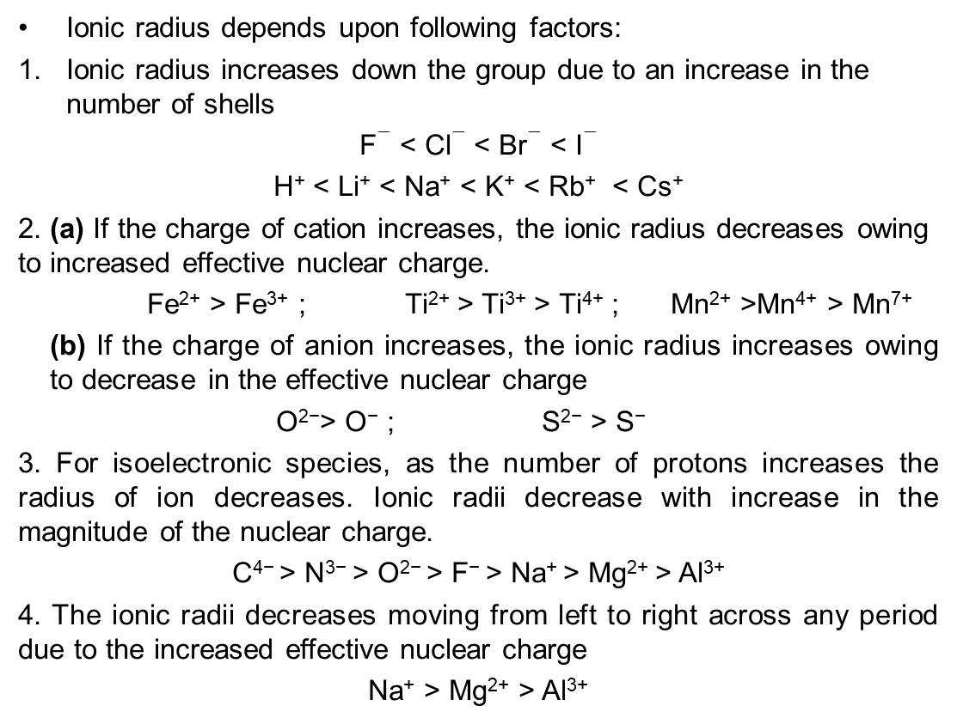
Ionic radius depends upon following factors:
Ionic radius increases down the group due to an increase in the number of shells
F$−$ < Cl$−$ < Br$−$ < I$−$
H⁺ < Li⁺ < Na⁺ < K⁺ < Rb⁺ < Cs⁺
2. (a) If the charge of cation increases, the ionic radius decreases owing to increased effective nuclear charge.
Fe²⁺ > Fe³⁺ ; Ti²⁺ > Ti³⁺ > Ti⁴⁺ ; Mn²⁺ >Mn⁴⁺ > Mn⁷⁺
(b) If the charge of anion increases, the ionic radius increases owing to decrease in the effective nuclear charge
O²⁻> O⁻ ; S²⁻ > S⁻
3. For isoelectronic species, as the number of protons increases the radius of ion decreases. Ionic radii decrease with increase in the magnitude of the nuclear charge.
C⁴⁻ > N³⁻ > O²⁻ > F⁻ > Na⁺ > Mg²⁺ > Al³⁺
4. The ionic radii decreases moving from left to right across any period due to the increased effective nuclear charge
Na⁺ > Mg²⁺ > Al³⁺

Slide 8
(3) Ionization energy:
Ionization energy (IE) is the energy required by an isolated gaseous atom to remove an electron in its ground state.
A_{(g)} ^{IE} A⁺_{(g)} + e⁻
It is measured in eV atom⁻¹ or kJ mol⁻¹.
Whenever an electron is removed from an atom, a specific amount of energy is required to remove it, hence the ionization enthalpies of chemical elements are always positive.
Successive ionization energy always increases because the e/p ratio gradually decreases i.e. effective nuclear charge increases, electrons will be tightly held and more potential will be required to take off the valence electron.
IE1 < IE2 < IE3
Ionization energy depends upon the following factors:
1. Atomic Size: IE decreases when shell number or the radius increases. Li>Na>K>Rb>Cs
2. Nuclear Charge: IE increases when nuclear charge increases. Li<Be>B<C<N>O<F<Ne
3. Screening effect of inner electrons: IE decreases when σ (shielding constant) increases.
4. Effect of arrangement of electrons: IE is more for half-filled and fully-filled electronic configurations (more stable confgns)
5. Penetration effect of the electrons: IE also depends upon the orbitals from which the electron is removed. If the principal quantum number is the same, then the energy required for removal of electrons from different orbitals shows the following order: s > p > d > f. => IE1 Al < IE1 Be

Slide 9
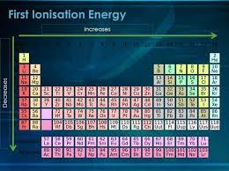
General periodic trends:
In a group, while moving from top to bottom it decreases.
It increases from left to right across a period.
1. Trends in ionization enthalpy in a group:
The first ionization enthalpy of elements decreases as we move down in a group. While moving down in a group, the atomic number increases and the number of shells also increases. Outermost electrons are far away from the nucleus and thus can be removed easily. The second factor that decreases the ionization energy is the shielding effect due to an increasing number of shells as we move down a group.
2. Trends in ionization enthalpy across a period:
As we move from left to right across a period, the ionization energy of elements increases. This is due to the decrease in the size of atoms across a period. The valence electrons get closer to the nucleus of an atom as we move from left to right due to increased nuclear charge. The force of attraction between the nucleus and the electrons increases and hence more energy is required to remove an electron from the valence shell.

Slide 10
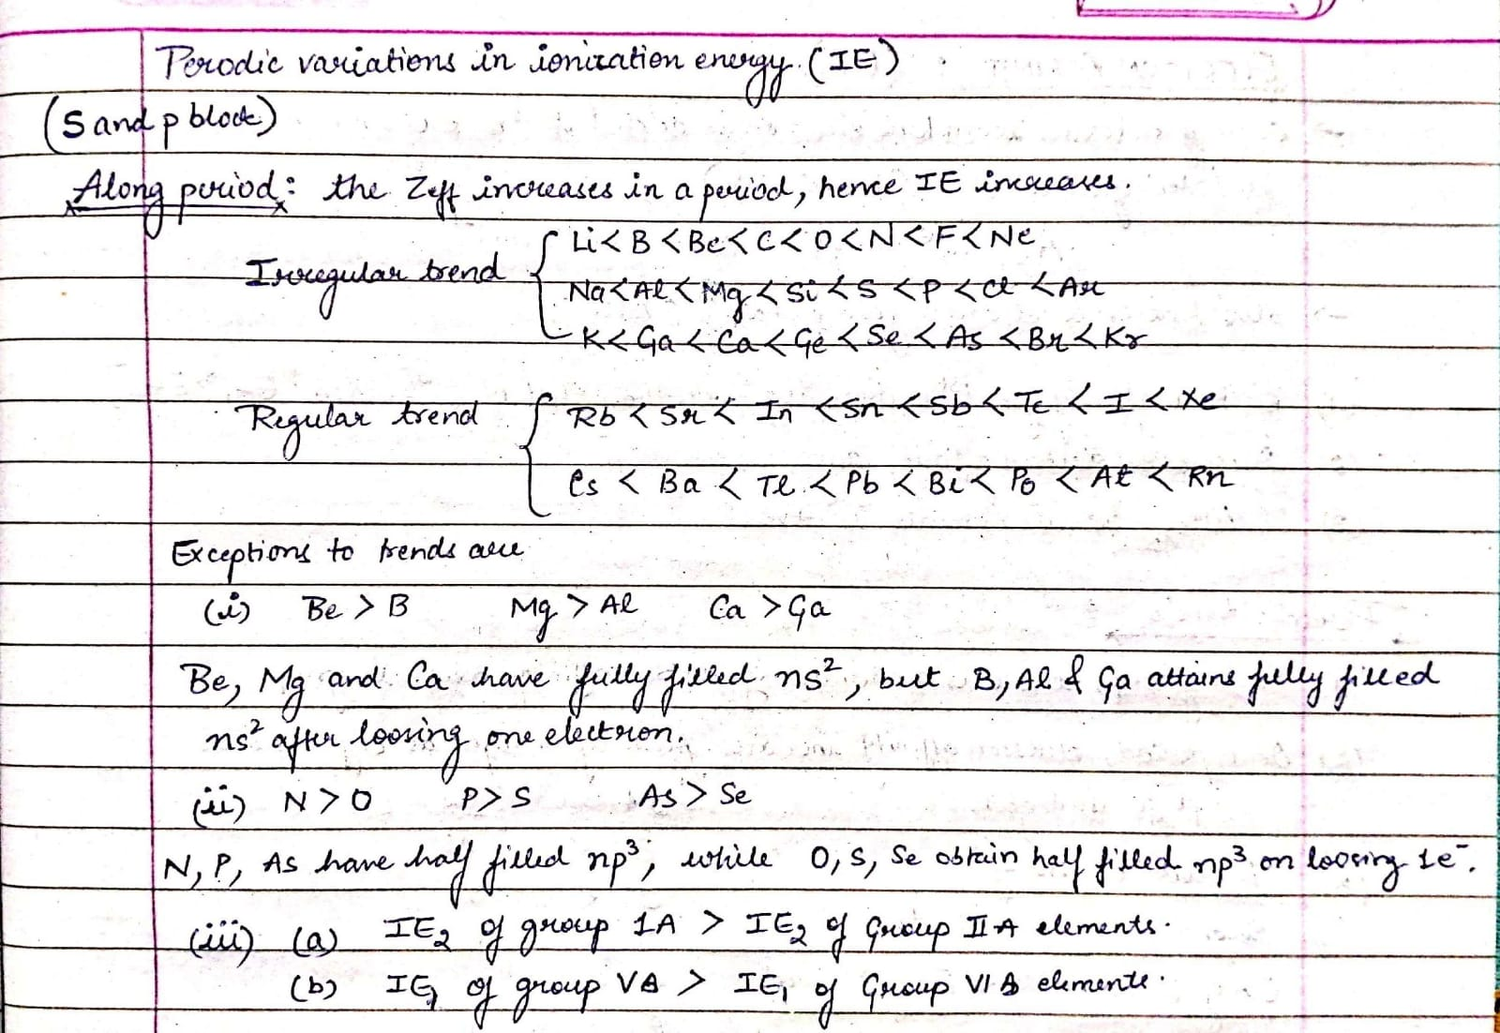

Slide 11
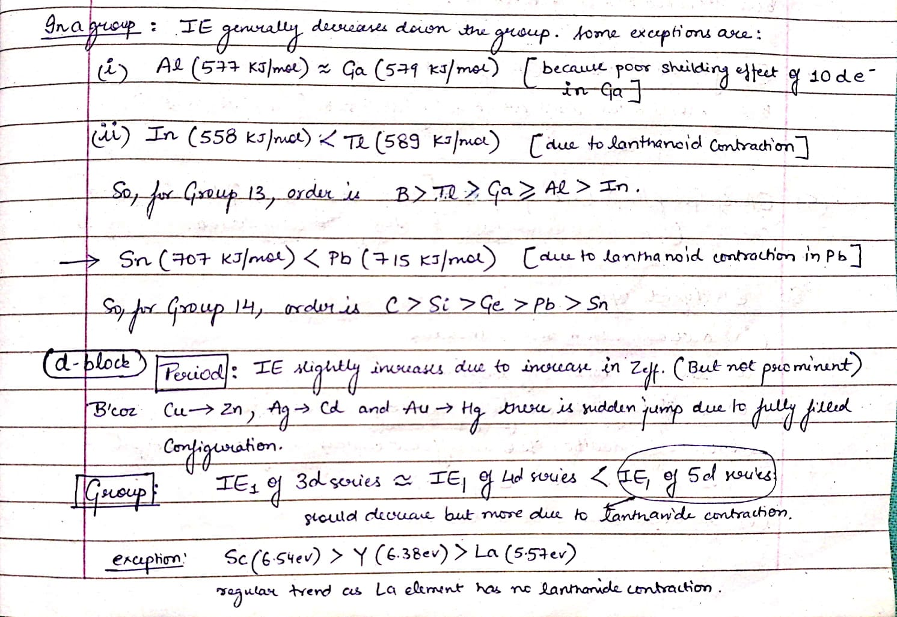

Slide 12
Electron affinity:
The electron affinity (EA) is the potential energy change of the atom when an electron is added to a neutral gaseous atom to form a negative ion. So the more negative the electron affinity the more favourable the electron addition process is.
A_{(g)} + e- → A⁻ ΔH=-ve
The electron gain enthalpy for halogens is highly negative because they can acquire the nearest stable noble gas configuration by accepting an extra electron.
Noble gases have large positive electron gain enthlapies because the extra electron has to be placed in the next higher principle quantum energy level thereby producing highly unstable electronic configuration.
Successive electron gain enthalpies: After the addition of one electron, the atom becomes negatively charged and the addition of second electron onto this negatively charged ion is opposed by inter-electronic repulsions and hence the energy has to be supplied resulting in positive second enthalpy.
Factors affecting EA:
1. Atomic size: If the atomic size increases, then there will be smaller electron gain enthalpy (less negative) as the distance between the nucleus and the last shell (receiving the electron) increases resulting in decrease forces of attraction between them. While in small sized atoms, enthalpy gain is more (more negative) because the effective nuclear forces will be greater in the smaller atoms and the electrons will be held firmly.
2. Nuclear charge: The greater the nuclear charge more will be the value for electron gain enthalpy (more negative) because an increase in nuclear charge will increase the effective nuclear force on valence electrons.
3. Electronic configuration: Half-filled and fully-filled orbitals are very stable and will have large positive gain enthalpy values.

Slide 13
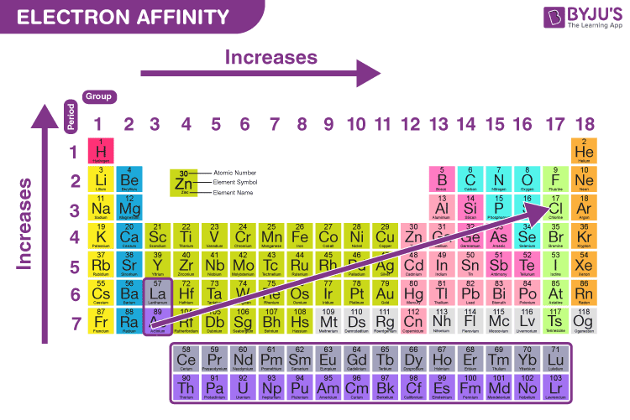
Electron Affinity variation in the periodic table
Trends in ionization enthalpy in a group:
Going down the group the electron affinity should decrease since the electron is being added increasingly further away from the atom.
Trends in ionization enthalpy across a period:
Electron affinity increases (more negative) going from left to right across a period. The overall trend across a period occurs because of increased nuclear attraction.
EA of second period< EA of third period elements because of presence of vacant d orbitals
B<Al; C<Si; N<P; O<S; F<Cl
Chlorine has the most negative electron gain enthalpy
EA of alkali metals> alkaline metals as the former will attain the stable configuration
EA of group 14 > group 15 because of half-filled configuration in the latter
Decreases

Slide 14
Electronegativity:
The tendency of an atom in a molecule to attract the shared pair of electrons towards itself is known as electronegativity.
It is a dimensionless property because it is only a tendency. It basically indicates the net result of the tendencies of atoms in different elements to attract the bond-forming electron pairs.
It is measured on the Pauling scale. According to this scale, fluorine is the most electronegative element with a value of 4.0 and cesium is the least electronegative element with a value of 0.7.
As we move across a period from left to right the nuclear charge increases and the atomic size decreases, therefore the value of electronegativity increases across a period.
Electronegativity decrease down the group. The nuclear charge also increases but the effect of the increase in nuclear charge is overcome by the addition of one shell.
Generally, metals show a lower value of electronegativity as compared to the non-metals. Therefore, metals are electropositive and non-metals are electronegative in nature.
Factors affecting electronegativity:
Size of an atom: A greater atomic size will result in less value of electronegativity, this happens because electrons being far away from the nucleus will experience a lesser force of attraction.
Nuclear charge: A greater value of nuclear charge will result in a greater value of electronegativity. This happens because an increase in nuclear charge causes electron attraction with greater force.
Effect of substituent: The difference in electronegativity of an atom caused by substituents results in different chemical behaviour of that atom.
Larger is the s-character, more is the electronegativity: sp>sp2>sp3

Slide 15
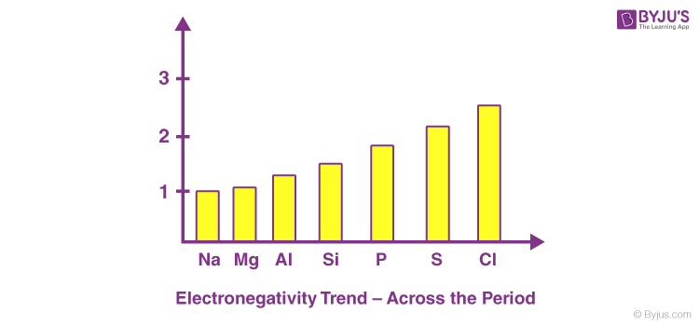
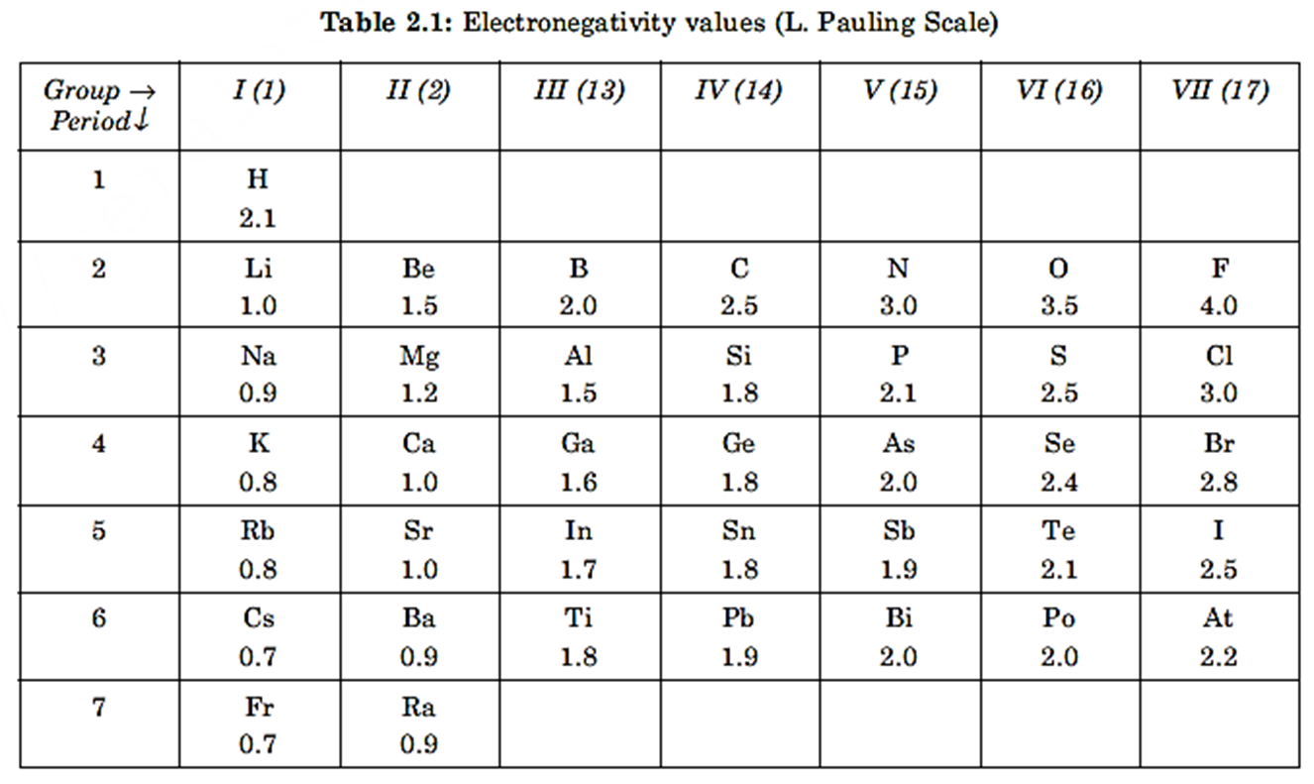
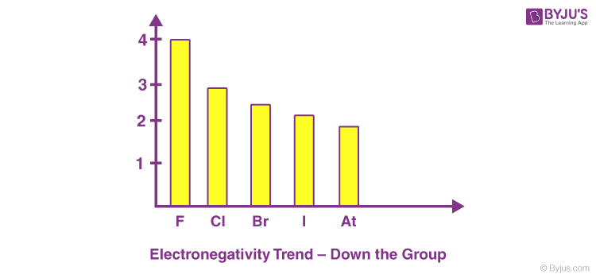
Electronegativity variation in the periodic table

Slide 16
s-block elements: outermost electronic shell configuration: ns¹⁻²
Group 1 (alkali metals) and Group 2 (alkaline earth metals)
Except H all elements of s-Block elements are active metals.
They have +1/ +2 oxidation state.
They form basic oxides
They impart characteristic colour to the flame due to the heat generated from the flame which excites the valence electrons from one energy level to another energy level. This helps in the detection of alkali metals during the flame test.
Generally they form ionic salts with nonmetals.
They have low ionization potentials
They have very small electron gain enthalpies.
They are solids at room temperature (Cs is liquid at about at 35oC)
Their hydroxides are basic in nature.
The density of the alkali metals increases down the group. Exception: the density of potassium is less than the density of sodium.
The alkali metals have a low melting and boiling point due to the weak metallic bonding.
(i) Atomic and Ionic Radii: Size of the alkali metals is larger compared to other elements in a particular period. As the atomic number increases the total number of electrons increases along with the addition of shells. Na+ > Mg2+
On moving down the group the atomic number increases. As a result, the atomic and ionic radius of the alkali metals increases. H+ < Li+ < Na+ < K+ < Rb+ < Cs+

Slide 17
(ii) Ionization potential: As we go down the group the size of the atoms increases due to which the attraction between the nucleus and the electrons in the outermost shell decreases. As a result, the ionization enthalpy decreases. The ionization enthalpy of the alkali metals is comparatively lesser than other elements.
(iii) Diagonal relationship:
Lithium and Beryllium differ much from the rest of their members but at the same time, they resemble more with the diagonal element present in the next column.
The anomaly of these S-block elements is due to:
Low atomic and ionic size
Greater charge density (charge/volume of the atom)
Greater polarization
Absence of d-orbitals.

Slide 18
p-block elements: outermost electronic shell configuration: ns², np¹⁻⁶
Most of p-Block elements are non-metals.
They have variable oxidation states.
They form acidic oxides
They impart no characteristic colour to the flame
Generally they form covalent compounds. Halogens form salts with alkali metals
They have very large electron gain enthalpies.
They are solids/liquids/gases at room temperature (Br is liquid)
The aqueous solutions their oxides are acidic in nature.
p- block elements consist of
Group 13 Elements: Boron family
Group 14 Elements: Carbon family
Group 15 Elements: Nitrogen family
Group 16 Elements: Oxygen family
Group 17 Elements: Fluorine family
Group 18 Elements: Neon family
In the period from left to right, there is a regular increase in non-metallic character. However, non-metallic character decreases in the groups from top to bottom.
Ionization energies increase from left to right in a period while decrease in a group from top to bottom. Group VA and zero group have exceptionally high values of ionization energies on account of half-filled and fully filled orbitals in the valency shell.
The first member of the p block elements differs from other elements in two major respects:
First is the size and each and every property which depends upon the size.
The second difference applies only to the p-block element, which arises from the effects of d-orbitals in the valence shell of heavier elements.

Slide 19
d-block elements: Elements having electrons (1 to 10) present in the d-orbital of the penultimate energy level and in the outermost ‘s’ orbital (1-2) are d block elements.
Electrons added to the ‘d’ sub-orbitals that lie between their (n+1) s and (n+1) p sub-orbitals.
The general electronic configuration of d-block elements is (n-1)d1-10ns0-2.
There are four series in the d block corresponding to the filling up of 3d, 4d, 5d or 6d orbitals.
3d- Sc, Ti, V, Cr, Mn, Fe, Co, Ni, Cu, Zn
4d- Y, Zr, Nb, Mo, Tc, Ru, Rh, Pd, Ag, Cd
5d- La, Hf, Ta, W, Re, Os, Ir, Pt, Au, Hg
6d- incomplete.
d-block elements are called transition metals indicating their positioning and transition of properties between, s and p block elements.
Anomalies do occur in all the series, which can be explained from the following considerations:
The energy gap between the ns and (n-1) d orbitals
Pairing energy for the electrons in s-orbital
Stability of half-filled orbitals to the partly filled orbitals.
Unpaired electrons and the empty or partially filled d-orbitals form covalent bonding in addition to the metallic bonding by s-electrons. Because of such strong bonding, d-block elements have high melting and boiling points than s and p block elements. This trend goes till d5 configuration and then decreases as more electrons get paired in the d-orbital.
Mercury – the liquid metal: Mercury is the only metal that exists in its liquid state at room temperature. 6s valence electrons of Mercury are more closely pulled by the nucleus (lanthanide contraction) such that outer s-electrons are less involved in metallic bonding.

Slide 20
Atomic and ionic radii of elements of all three-transition series
Decreases rapidly, from column 3 to 6
Remains steady, from column 7 to 10 and
Starts increasing from column 11 to 12.
For example, in the first transition series, atomic radii, the decrease is more from Sc to Cr (group 3 to 6 ), is almost the same for Mn, Fe, Co, Ni (group 7,8 9 &10) and increase in cu and Zn.
The larger decrease in atomic radii, in column 3 to 6 elements is due to the increase in effective nuclear charge but poor shielding because of the smaller number of d-electrons.
In elements of column 7 to 10 increasing effective nuclear charge is balanced by the repulsion between the shared d electrons so that radii remain the same.
In the case of 11 and 12 columns elements, the d orbital is full with ten electrons and shield the electrons present in the higher s-orbital. So, groups 11 and 12 elements like Cu and Zn have bigger sizes than their earlier elements in the block.
Since electrons occupy a higher orbital, radii of the third series are to be more than the second series elements. But radii of both series are almost the same. In the third series of elements, 5d orbitals are filled only after the filling up of 4f orbitals, which increases the effective nuclear charge by 14 units.
This higher nuclear charge leads to the larger shrinkage of radii known as Lanthanide contraction. An increase in radii due to the higher orbital will be effectively neutralized by the increase in the nuclear effective charge. So, radii of second and third series elements have the same atomic radii. For example, Niobium and hafnium have almost the same atomic radii.

Slide 21
Ionization Energy of the d block elements is larger than s-block and smaller than the p-block elements, between which, they are placed. In the first series, except chromium and copper first Ionization Energy involves removal from filled s-orbital. Among them, the ionization energy of d block elements increases with the increase in atomic number up to Fe.
In Co and Ni, increasing sharing of d-electrons compensate for the atomic number increase resulting in the decrease of Ionization Energy. Copper and zinc show increasing IE, as s -block elements. In the second series, elements from Niobium have single electrons in the s-orbital.
Hence, they show a gradual increase in IE with increasing atomic number. Palladium, on the other hand, has a completed d-shell and no electron in the s-shell. So, Pd shows the maximum IE. Because of lanthanide contraction, the attraction of electrons by the nuclear charge is much higher and hence IE of 5d elements are much larger than 4d and 3d. In 5d series, all elements except Pt and Au have filled s-shell.
Elements from Hafnium to rhenium have the same IE and after IE increases with the number of shared d-electrons such that Iridium and Gold have the maximum IE.

Slide 22
f-block elements: Electronic configuration: ns2 (n-) d0-1(n-2) f1-14
They are also called as inner transition elements. They are: Lanthanides and actinides.
Lanthanides. (58Ce- 71Lu ): last electron enters into 4f-orbital
All lanthanides closely resemble lanthanum
Lanthanoids are chemically similar to each other
Except for cerium (III and IV) and europium (III and II), the lanthanides occur as trivalent cations in nature. Most lanthanides are widely used in lasers
These elements deflect UV and Infrared electromagnetic radiation and are commonly used in the production of sunglass lenses.
The ionic radii of the lanthanoids decrease through the period — the so-called lanthanide contraction
Actinides( 90Th– 103Lr): last electron enters into 5f-orbital
All the actinides are radioactive
These are highly electro-positive ( show+3,+4,+5,+6 oxidation states)
These metals tarnish in air
They have number of isotopes.
They react with boiling water or dilute acids to give H2 gas.
These directly combine with non-metals.
Similarities between Lanthanides and Actinides:
· Both lanthanides and Actinides show +3 oxidation states
· Both are electropositive and very reactive
· Both are paramagnetic

